Slide 1

KICK OFF MEETING
COMMUNICATION PLAN
18th April
Turin, Italy
Azaro Fundazioa
Maria Txakartegi
Politecnico di Torino

Slide 2
Communication Objectives
Engage, persuade and inform Stakeholders
Sensitize politicians, legislators, businesses and society on the tangible benefits of the transition to Circular Economy
Create a roadmap that makes visible the benefits of the transition and the next steps for the adoption of SD
To disseminate the project achievements and results: SD method, Good Practices Roadmap and Policy Recommendations
Contribute to good practices, policy recommendations and reports in the Learning Platform Regarding Energy Efficiency Europe Interreg

Slide 3
Communication Results
MAIN EXPECTED OUTPUTS RELATED TO COMMUNICATION
7 Interregional events organised to exchange experience: 5 Field Visits and Peer Review workshops to the 5 partner regions and 2 Field Visits of 2 good practices identified outside the partnership of interest to the partnership in Scotland (UK) and The Netherlands, completing the scope of parners´good practices: participation of 26 partners and stakeholders at each: 182 people.
5 Policy Briefs targeting politicians and policy-makers with tangible benefits and potential impact
10 regional Dissemination Events held (2 Dissemination Events at each region, S1 and S4): 400 attendants
2 Interregional Dissemination Events held (Brussels at S4 and Slovenia at S7): 200 attendants. At least 20 politicians and policy-makers engaged on Policy Panel at last event.
3 publications produced and disseminated to different target groups: A) "RETRACE Method for Systemic Approaches on Circular Economy" aimed at regional policy-makers and policy-managers. B) "RETRACE Good Practices Guide on Systemic Approaches on Circular Economy" aimed at policy-managers, companies, industries, NGOs, society. C)"Policy Road Map for a Systemic Approach on Circular Economy": aimed at policiticans and policy-makers
200 articles/appearances in press and media and one video with 1000 views.
1240 participants in dissemination events: 10 regional Dissemination Events: 40 people * 10 events = 400 people + 2 Interregional Dissemination Events: 100 people * 2 events = 200 + RETRACE active presentation by 8 partners on 2 external events each: 40 people * 16 events = 640 people

Slide 4
Semester 1 Communication Actions and Main Outputs
S1 will be devoted to the definition of the Communication & Dissemination Strategy, the appointment of CO and the setup of main communication tools:
Actions
Outputs
Agreement by Steering Group (SG) of Communication & Dissemination Strategy proposed by PP3, partner coordinating Communication: agreement on goals, target groups, messages, communication tools & activities, time plan and indicators to be monitored in RETRACE balanced scorecard.
Definition of 5 (one per country) Communication Plans with indication of target groups, mass media and specific messages and activities to carry out.
Appointment by PP3, of a Chief Communication Officer. Appointment by all partners of Communication Officers.
External contract by PP3 of Project Image Handbook.
Production by PP3 of Project Posters and delivery to all partners.
Delivery by PP3 of contents for website under INTERREG EUROPE system and agreement on news feeding system among Communication Officers. Setup of RETRACE social media tool and links with website and programme ones: Facebook, Linkedin,Twitter and YouTube.
Press release with occasion of Kickoff meeting in Turin, Italy and Aquitaine Field Visit.
External services contracted by PP5 for the video of the Field Visits to Aquitaine, PP1 internally records the one in Piedmont.
5 regional dissemination events with 3 goals: 1) promotion and dissemination of project; 2) raise awareness on Circular Economy and 3) engagement of Stakeholders Groups
Communication & Dissemination Strategy % 5 Communication Plans
Communication Officer appointed
5 Dissemination Events held: 182 attendants
Project Poster available
Project website under INTERREG EUROPE platform and social media profiles
Press releases with ocassion of Field Visits

Slide 5
Semester 2 Communication Actions and Main Outputs
This semester will focus on the implementation of the Communication Strategy:
Outputs
Actions
Production by PP3 of Brochure in English and delivery to all partners for printing. Brochure designed as a folder to be used on all kind of meetings and events.
Communication Officer (CO) from PP3 will update once a month website. S/he will coordinate with partners’ COs a timetable for the delivery of relevant news related to the project activities and to the Circular Economy topic.
COs from all partners will get access to social media profiles, and will feed them continuously.
CO from PP3 will produce a digital newsletter template and feed calendar. A consolidated distribution list will be developed with contact information provided by partners.
First newsletter will be available by October 2016. All in all, 7 newsletters are scheduled. Newsletter will be elaborated in English and disseminated semestrially.
Press releases with occasion of the 2 Field Visits.
External services contracted by PP3 for the video recording of the Field Visits to Basque Country and to The Netherlands.
CO from PP3 will keep track of all relevant events at EU level related to the Circular Economy topic. S/he will share this information with all partners. Participation of partners at such events for the active dissemination of the project will be encouraged. To that end, all partners have a travel budget. Following participation an Impact Report will be delivered by participating partner.
RETRACE Brochure
RETRACE 1st newsletter distributed: 250 contacts
Press releases with occassion of Field Visit

Slide 6
Semester 3 Communication Actions and Main Outputs
This semester will focus on the implementation of the Communication Strategy:
Actions
Outputs
LP will subcontract the professional layout of “RETRACE Method for Systemic Approaches on Circular Economy” publication to be available in English. LP will deliver to partners the file who will be in charge of their printing. Digital version of the publication available at website.
CO from PP3 will update once a month RETRACE website. S/he will coordinate with partners’ COs a timetable for the delivery of relevant news related to the project activities and to the Circular Economy topic.
COs from all partners will get access to RETRACE social media profiles, and will feed continuously the Facebook, Linkedin, Twitter and YouTube profiles.
CO from PP3 will produce 2nd newsletter will be available and distributed by May 2017.
Press releases with occasion of RETRACE Field Visits to Slovenia, Romania and Scotland.
External services contracted by PP7 and PP8 for the video recording of the Field Visits to Slovenia and Romania.
CO from PP3 will keep track of all relevant events at EU level related to the Circular Economy topic. S/he will share this information with all partners.
Participation of RETRACE partner at such events for the active dissemination of the project will be encouraged. To that end, all partners have a travel budget. Following participation at such events an Impact Report will be delivered by participating RETRACE partner.
RETRACE “Method for Systemic Approaches on Circular Economy” publication
RETRACE 2nd newsletter distributed: 250 contacts
Press releases with occasion of Field Visits

Slide 7
Semester 4 Communication Actions and Main Outputs
This semester will focus on the production of main project outputs and on their dissemination through regional and interregional events:
Actions
Outputs
LPwill subcontract the layout of “RETRACE Good Practices Guide” in English. LP will deliver to partners to file who will be in charge of their printing.
PP3 will subcontract the layout of “Policy Road Map” in English. PP3 will deliver to partners to file who will be in charge of heir printing.
With video recordings from all Field Visits, PP3 will subcontract the production of a RETRACE video, with information on Field Visits and infographics with resulting Action Plans.
Holding of 5 RETRACE regional dissemination events for presenting the publications, regional Policy Briefs and Action Plans.
Holding of RETRACE interregional event, to be held in Brussels, Belgium, in March 2018, organised by LP and PP3 (as Communication activities responsible). It will hold 2 main sections: 1) an interregional
Policy Panel with partner regions’ politicians and policymakers, EU policymakers and MEPs for disseminating the regional Policy Briefs and Policy Road Map. Internal event not open to public audience; 2) open conference targeting EU regions representatives, development agencies and other stakeholders involved on the promotion of Circular Economy.
Update of website and social media profiles.
3rd newsletter distributed by December 2017.
Participation at other INTERREG EUROPE or Circular Economy related events.
RETRACE “Good practices Guide”
RETRACE “Policy Road Map”
5 regional Dissemination Events: 210 attendants
1 Interregional Dissemination Event: 100 attendants, including 20 politicians
RETRACE video & infographics with Phase 1 results
RETRACE 3rd newsletter distributed: 250 contacts
Press releases with occasion of dissemination events

Slide 8
Semester 5 and Semester 6 Communication Actions and Main Outputs
The partners ensure regular updates of the project website with information on the action plans implementation.
Outputs
Semester 7 Communication Actions and Main Outputs
Website updates
The partners organise a final dissemination event gathering executives and policy makers from the regions and from other relevant institutions. The aim is to promote the project achievements and to disseminate the results of the action plans implementation to a large audience. The project website is updated accordingly.
Semester 8 Communication Actions
The partners ensure regular updates of the project website with information on the action plans implementation.

Slide 9
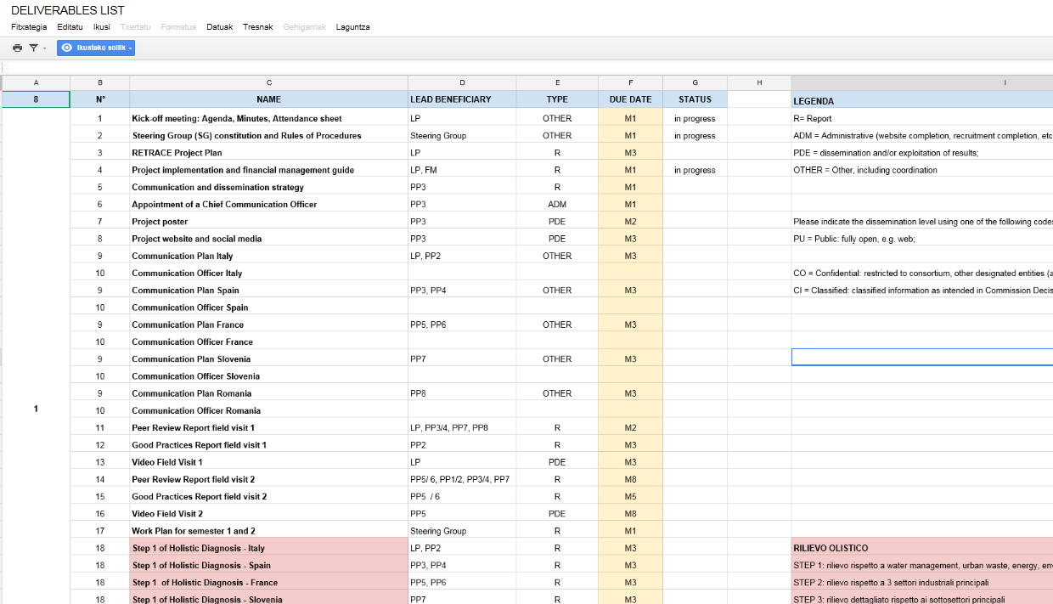
Next steps: Implementation Plan example S1
The implementation plan and deliverables are in the link below:
https://docs.google.com/spreadsheets/d/1zrV3FsBL28BQx26j360Wkk5srroFhogxgpWIN35tigs/edit?pref=2&pli=1#gid=0
Communication Plan: activities, responsible…

Slide 10
Next steps: Implementation Plan example S1
RETRACE Activities | Channel | Responsible | Notes
1st Dissemination Event / Local Stakeholder Group meeting SPAIN | Meeting_Event | Azaro-Beaz | Obj 1: to engage stakeholder, promote and disseminate CE. Obj2: Present the goals of their involvement on RETRACE, the activities where they will be involved such us Field Visits and Action Plans definition. To provide updated project information and consecution of intermediate and final objetictives and results Obj 3: 40 people in each event 5 Stakeholders Groups created and engaged: 50 people + 5 regional dissemination events in S1
1st Dissemination Event / Local Stakeholder Group meeting FRANCE | Meeting_Event | ESTIA-APESA
1st Dissemination Event / Local Stakeholder Group meeting ITALY | Meeting_Event | Polito-Piamonte
1st Dissemination Event / Local Stakeholder Group meeting ROMANIA | Meeting_Event | Romania
1st Dissemination Event / Local Stakeholder Group meeting SLOVENIA | Meeting_Event | Slovenia
1st Local Stakeholder Group meeting | Meeting_Event | ---
1st Field Visit PIEDMONT FIELD VISIT | Field Visit | Polito-Piamonte | Stakeholders are also expected to take part in the 7 field visits. Obj: to learn good practices from other regions
2nd Field Visit AQUITAINE FIELD VISIT | Field Visit | ESTIA-APESA

Slide 11
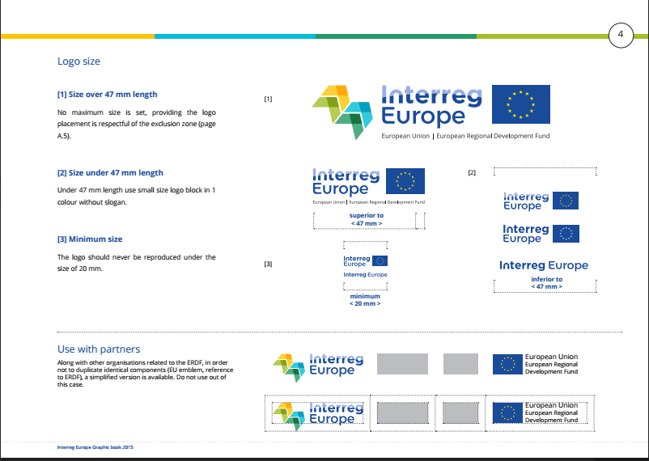
Interreg Europe Graphic Book:
The Interreg Europe Graphic guide is in the link below :
https://drive.google.com/folderview?id=0B1x-EszTKQAwLTJCQ1llWS0tdHc&usp=sharing

Slide 12
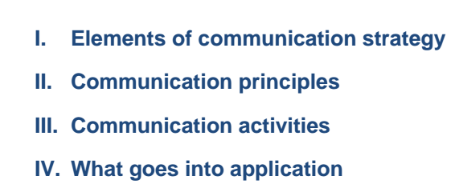
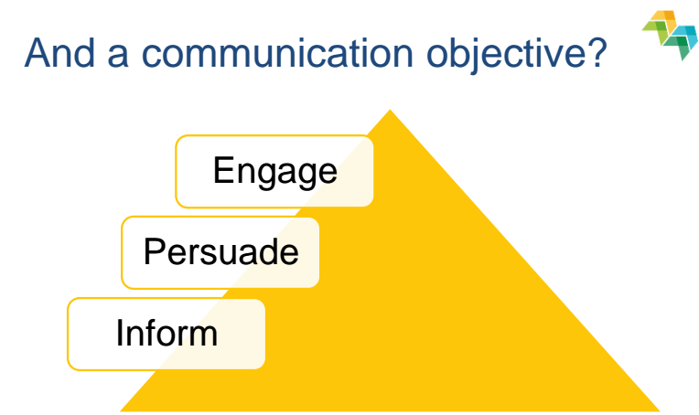
Designing a Project communication strategy:
The Communication Plan Strategy documents are in the link below:
https://drive.google.com/folderview?id=0B1x-EszTKQAwLTJCQ1llWS0tdHc&usp=sharing

Slide 13
STEP 1_Target Group Mapping & Planning:
The Communication Plan Strategy documents are in the link below:
https://drive.google.com/folderview?id=0B1x-EszTKQAwLTJCQ1llWS0tdHc&usp=sharing

Slide 14
STEP 2_Target Group Mapping & Planning:
The Communication Plan Strategy documents are in the link below:
https://drive.google.com/folderview?id=0B1x-EszTKQAwLTJCQ1llWS0tdHc&usp=sharing

Slide 15
STEP 3_Target Group Mapping & Planning:
The Communication Plan Strategy documents are in the link below:
https://drive.google.com/folderview?id=0B1x-EszTKQAwLTJCQ1llWS0tdHc&usp=sharing

Slide 16
RETRACE - SOCIAL MEDIAS
Please, try to post Retrace Project information by the following details:
Twitter: @Interregeurope
#Retrace
#Interregeurope
#SD (systemic design)
#CE (circular economy)
#output
#input
#PoliTOnews
#Azarofundazioa
…

Slide 17
CONTACT DETAILS
Retrace - Communication Manager
Maria Txakartegi Laka
mtxakartegi@azarofundazioa.com
Tel. +34 946 169 172
Skype: azarofundazioa
Twitter: @Azarofundazioa
Facebook: Azaro Fundazioa Lea-Artibai

